Slide 1
Unit 5: Software project management 1. Project management 2. Project planning and control 3. Cost estimation 4. Project scheduling using PERT and GANTT charts 5. Software configuration management

Slide 2
Project Management
Project management is the practice of initiating, planning, executing, controlling, and closing the work of a team to achieve specific goals and meet specific success criteria within a specified time frame.
It involves coordinating various resources, including people, time, money, and materials, to bring about the successful completion of a project.

Slide 3
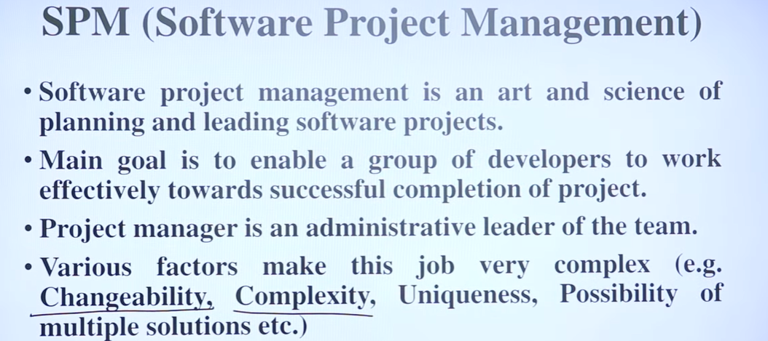

Slide 4
Key aspects of project management include:
Initiating: Defining the project, its objectives, scope, and stakeholders (persons involved in a project)
Planning: Creating a detailed project plan outlining tasks, timelines, resources, and budgets.
Executing: Carrying out the project plan, coordinating resources, and managing stakeholders.

Slide 5
Monitoring and Controlling: Tracking project progress, identifying and addressing issues, and managing changes to the project scope, schedule, and budget.
Closing: Finalizing all project activities, delivering the final product or service to the customer, and obtaining formal acceptance and closure.

Slide 6
Real Life Examples

Slide 7
Construction of a new office building:
Initiating: A company decides to construct a new office building to accommodate its growing workforce and enhance its facilities.
Planning: Architects design the building, engineers create structural plans, permits are obtained, and a construction timeline and budget are established.
Executing: Construction begins, with contractors hired to carry out various tasks such as site preparation, foundation laying, building erection, and interior finishing.

Slide 8
Monitoring and Controlling: Project managers oversee the construction progress, ensuring that work is on schedule, quality standards are met, and any issues are addressed promptly.
Closing: Once construction is complete, final inspections are conducted, and the building is handed over to the company. Any remaining tasks are completed, and the project is formally closed.

Slide 9
Launch of a new smartphone:
Initiating: A tech company decides to develop and release a new smart phone model to compete in the market.
Planning: The company plans the phone's features, design, manufacturing process, marketing strategy, and distribution channels.
Executing: Engineers develop the phone, designers create its look, factories manufacture it, and marketing teams promote it through various channels.

Slide 10
Monitoring and Controlling: The company tracks production progress, market response, and sales figures, making adjustments as needed to ensure a successful launch.
Closing: After the phone is released, the company evaluates its performance, gathers feedback from customers, and plans for future updates or models.

Slide 11
Project managers play a crucial role in overseeing all aspects of a project and ensuring that it is completed successfully, on time, and within budget. They often use various tools and techniques, such as Gantt charts, critical path analysis, and risk management, to effectively manage projects from start to finish.

Slide 12
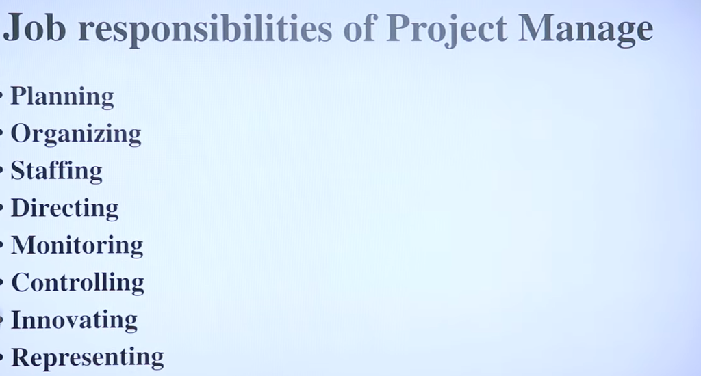

Slide 13
Responsibility of project managers
Project proposal writing,
Project cost estimation,
Scheduling,
Project staffing,
Project monitoring and control,
Software configuration management,
Risk management,
Managerial report writing and presentations, etc.

Slide 14
Question
What are the necessary skills a project manager should have?
Knowledge of project management techniques
Decision taking capabilities.
Previous experience in managing similar projects.
All of above

Slide 15
Project Planning and Control
Project planning and control are essential aspects of project management that involve organizing, overseeing, and adjusting the various elements of a project to ensure its successful completion.

Slide 16
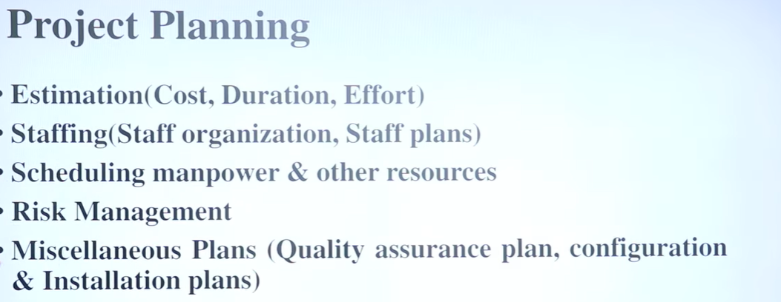

Slide 17
Project Planning
Scope Definition: Clearly define the project's objectives, deliverables, tasks, and requirements.
Work Breakdown Structure (WBS): Break down the project into smaller, manageable components or tasks.
Scheduling: Develop a timeline for the project, identifying key milestones and setting deadlines for each task.
Resource Planning: Determine the human, financial, and material resources needed for the project and allocate them accordingly.

Slide 18
Risk Management: Identify potential risks and develop strategies to mitigate or respond to them.
Communication Plan: Establish communication channels and protocols for team members, stakeholders, and other relevant parties.
Quality Planning: Define quality standards and procedures to ensure that project deliverables meet expectations.

Slide 19
Project planning
Requires utmost care and attention --- commitments to unrealistic time and resource estimates result in:
irritating delays.
customer dissatisfaction
adverse affect on team morale
poor quality work
project failure.

Slide 20
Sliding Window Planning
Involves project planning over several stages:
protects managers from making big commitments too early.
More information becomes available as project progresses.
Facilitates accurate planning

Slide 21
SPMP Document
After planning is complete:
Document the plans:
in a Software Project Management Plan(SPMP) document.

Slide 22
Organization of SPMP Document
Introduction (Objectives,Major Functions,Performance Issues,Management and Technical Constraints)
Project Estimates (Historical Data,Estimation Techniques,Effort, Cost, and Project Duration Estimates)
Project Resources Plan (People,Hardware and Software,Special Resources)
Schedules (Work Breakdown Structure,Task Network, Gantt Chart Representation,PERT Chart Representation)
Risk Management Plan (Risk Analysis,Risk Identification,Risk Estimation, Abatement Procedures)
Project Tracking and Control Plan
Miscellaneous Plans(Process Tailoring,Quality Assurance)

Slide 23
Question
Which technique is used to plan the project is several stages?
Project estimation planning
Sliding window planning
Project Documentation Plan
None of above

Slide 24
Project Control
Monitoring Progress: Regularly track the project's progress against the planned schedule, budget, and quality standards.
Performance Measurement: Collect data on key performance indicators (KPIs) to assess project performance and identify areas for improvement.
Change Management: Manage changes to the project scope, schedule, or resources, evaluating their impact and making adjustments as necessary.

Slide 25
Issue Resolution: Address any issues or challenges that arise during the project, implementing solutions to keep the project on track.
Cost Control: Monitor project expenses and expenditures, ensuring that the project stays within budget.
Quality Control: Conduct inspections and reviews to verify that project deliverables meet quality standards.
Communication and Reporting: Keep stakeholders informed of project progress, issues, and changes through regular updates and reports.

Slide 26
Project planning and control involve organizing and overseeing the tasks and resources of a project to ensure it stays on track and meets its objectives.
For instance, in building a house, planning involves designing blueprints, scheduling construction phases, and allocating resources. Control entails monitoring progress, adjusting schedules if delays occur, and managing changes such as modifications to the design.

Slide 27
Software Cost Estimation
Determine size of the product.
From the size estimate,
determine the effort needed.
From the effort estimate,
determine project duration, and cost.

Slide 28
Software Cost Estimation
Effort Estimation
Cost Estimation
Size Estimation
Staffing Estimation
Duration Estimation
Scheduling

Slide 29
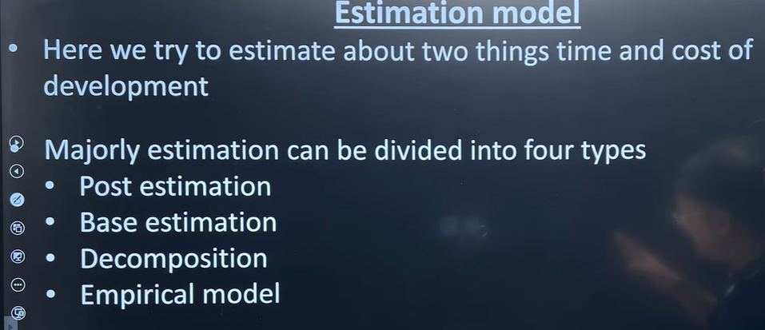

Slide 30
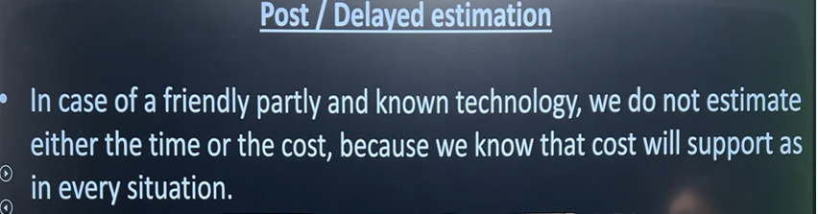

Slide 31
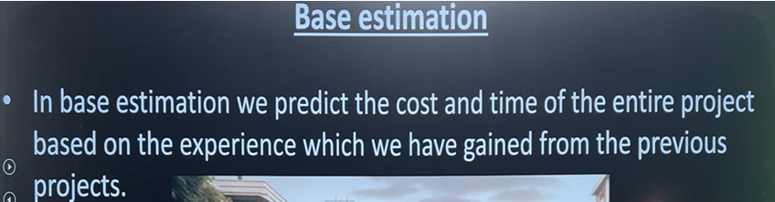

Slide 32
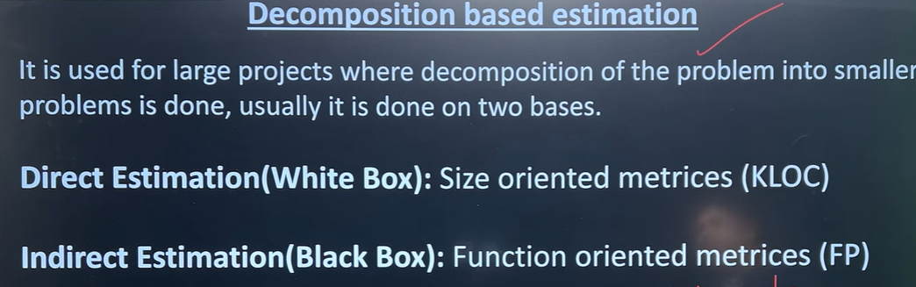

Slide 33
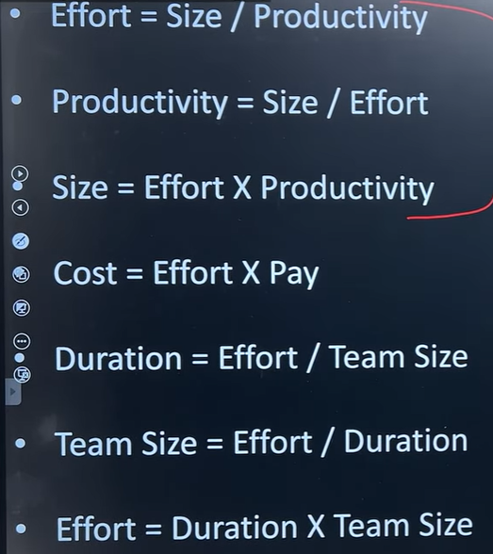
3 Formulas

Slide 34
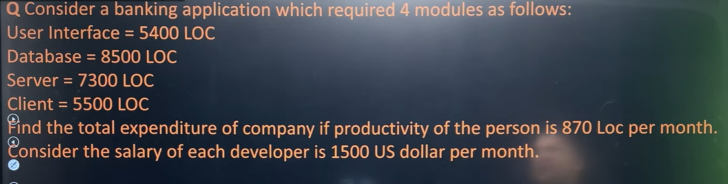

Slide 35
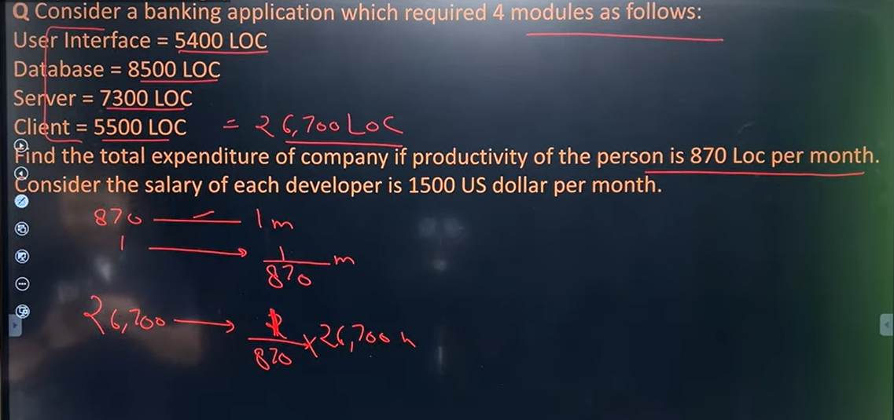

Slide 36

Cost= effort*Pay

Slide 37
30.6 Person month
One person will work for 30.6 months
Or
30.6 persons will work for 1 month

Slide 38
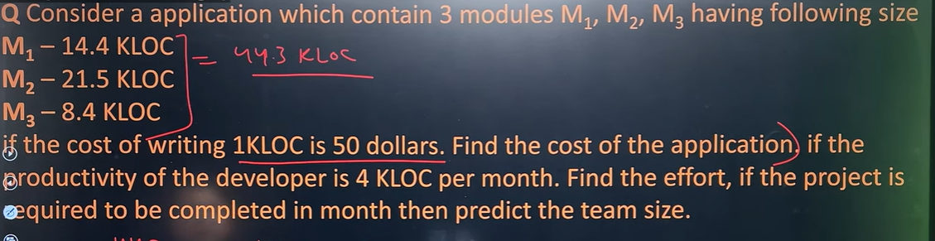

Slide 39
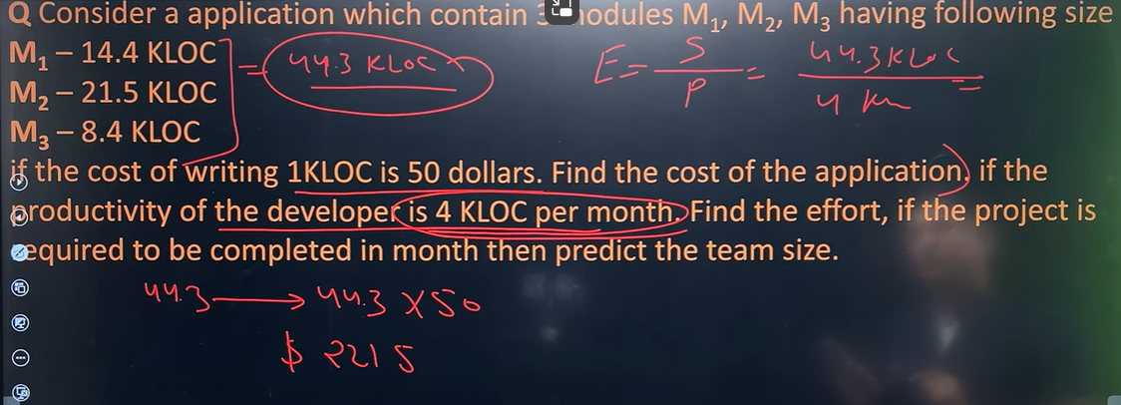

Slide 40


Slide 41
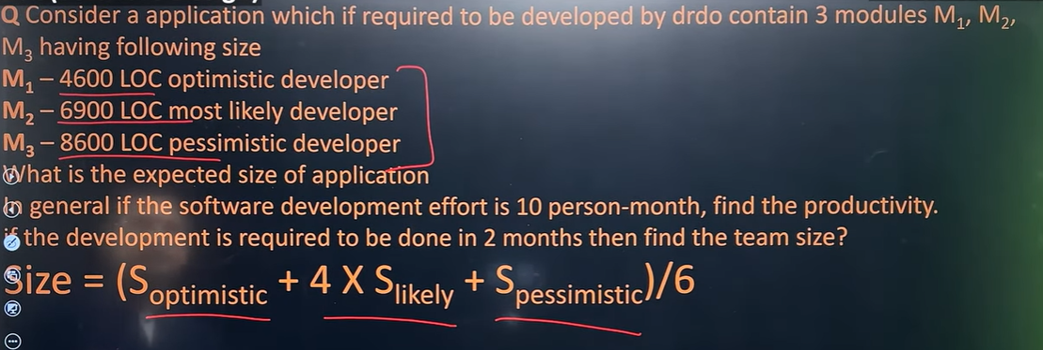

Slide 42
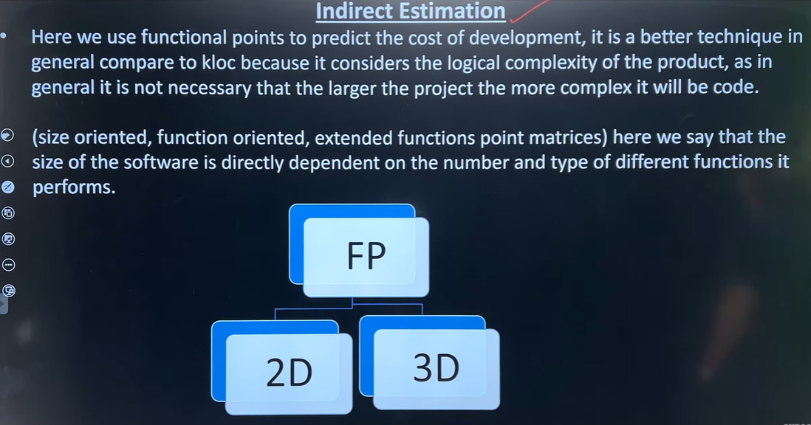

Slide 43
Software Size Metrics
LOC (Lines of Code):
Simplest and most widely used metric.
Comments and blank lines should not be counted.

Slide 44
Disadvantages of Using LOC
Size can vary with coding style.
Focuses on coding activity alone.
Correlates poorly with quality and efficiency of code.
Penalizes higher level programming languages, code reuse, etc.

Slide 45
Disadvantages of Using LOC (cont...)
Measures lexical/textual complexity only.
does not address the issues of structural or logical complexity.
Difficult to estimate LOC from problem description.
So not useful for project planning

Slide 46
Payment as per size
Long term problem: Good programmer, small program, not genuine
Complexity may vary
Code for compiler or university website?
Painting a house or actual painting?
Kms charges with different vehicles will be different

Slide 47
Function Point Metric
Overcomes some of the shortcomings of the LOC metric
Proposed by Albrecht in early 80’s:
The function point metric is based on the idea that a software product supporting many features would certainly be of larger size than a product with less number of features.

Slide 48
Function Point Metric
Input:
A set of related inputs is counted as one input.
Output:
A set of related outputs is counted as one output.
Inquiries:
Each user query type is counted.
Files:
Files are logically related data and thus can be data structures or physical files.
Interface:
Data transfer to other systems.

Slide 49
Question
Which factor we have to evaluate first to estimate efforts of the software project?
Cost Estimation
Duration Estimation
Size Estimation
Staffing Estimation

Slide 50
Function Point (FP) is an element of software development which helps to approximate the cost of development early in the process. It may measures functionality from user’s point of view.

Slide 51
Function point (FP) metric computation
FP = UFP*TCF
Unadjusted function points (UFP)
Technical Complexity Factor (TCF)/ Complexity Adjustment Factor (CAF)

Slide 52
Step-1:
F = 14 * scale
As CAF = 0.65 + ( 0.01 * F )
Scale varies from 0 to 5 according to character of Complexity Adjustment Factor (CAF).
Below table shows scale:
0 - No Influence
1 - Incidental
2 - Moderate
3 - Average
4 - Significant
5 - Essential

Slide 53
Step-2: Calculate Complexity Adjustment Factor (CAF).
CAF = 0.65 + ( 0.01 * F )

Slide 54
Step-3: Calculate Unadjusted Function Point (UFP).
TABLE (Required)

Slide 55
The unadjusted function points (UFP) for average case is computed as the weighted sum of five characteristics of a product as shown in the following expression.
UFP = (Number of inputs)*4 + (Number of outputs)*5 + (Number of inquiries)*4 + (Number of files)*10 + (Number of interfaces)*7

Slide 56
Multiply each individual function point to corresponding values in TABLE.
Step-4: Calculate Function Point.FP = UFP * CAF

Slide 57
Question
How many steps are there to estimate the Function Point?
2
3
5
6

Slide 58

Software Project Planning
Example: 4.1
Consider a project with the following functional units:
Number of user inputs = 50
Number of user outputs = 40
Number of user enquiries = 35
Number of user files = 06
Number of external interfaces = 04
Assume all complexity adjustment factors and weighting factors are average. Compute the function points for the project.

Slide 59
Explanation:
Step-1: As complexity adjustment factor is average (given in question),
hence, scale = 3.
F = 14 * 3 = 42
Step-2:CAF = 0.65 + ( 0.01 * 42 ) = 1.07

Slide 60
Step-3: As weighting factors are also average (given in question) hence we will multiply each individual function point to corresponding values in TABLE.UFP = (50*4) + (40*5) + (35*4) + (6*10) + (4*7) = 628
Step-4:Function Point = 628 * 1.07 = 671.96 This is the required answer.

Slide 61
Function Point Metric (CONT.)
Suffers from a major drawback:
the size of a function is considered to be independent of its complexity.
Extend function point metric:
Feature Point metric:
considers an extra parameter:
Algorithm Complexity.

Slide 62
Function Point Metric (CONT.)
Proponents claim:
FP is language independent.
Size can be easily derived from problem description
Opponents claim:
it is subjective --- Different people can come up with different estimates for the same problem.

